Slide 1
Priory School Alexa Skill
Akash Ganesan
Notes:
Welcome to my Priory School Senior project presentation. Computer “Roll the video…”

Slide 2
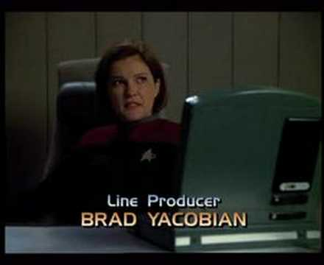

Slide 3
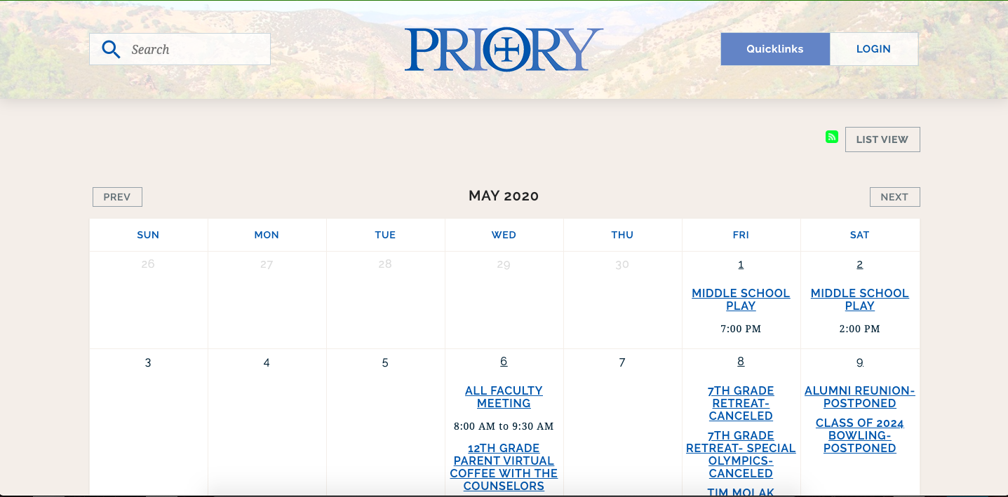
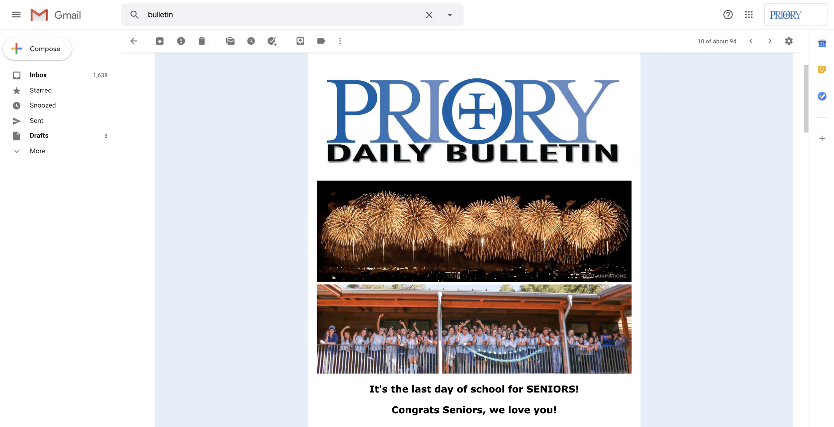
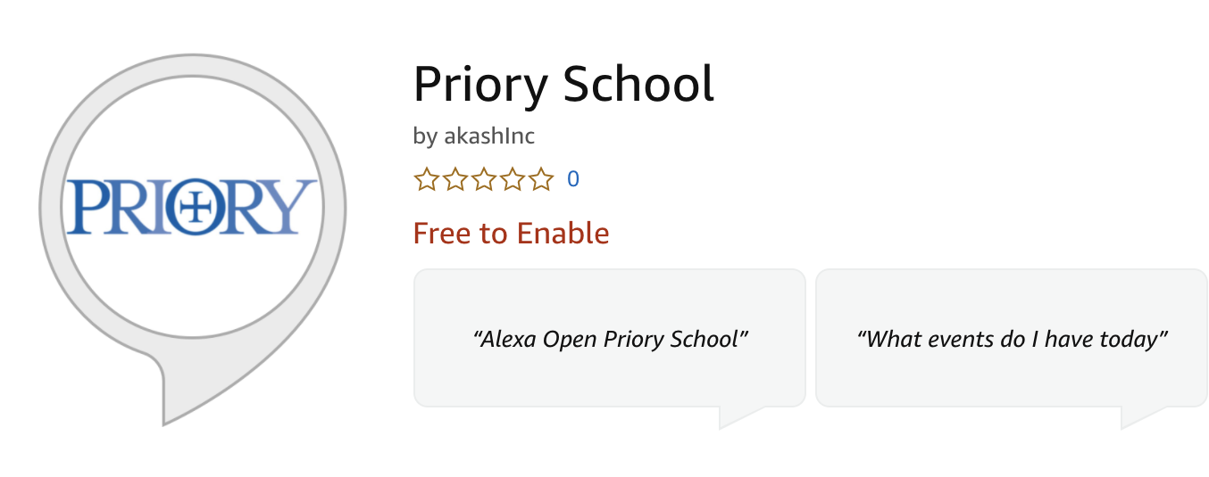
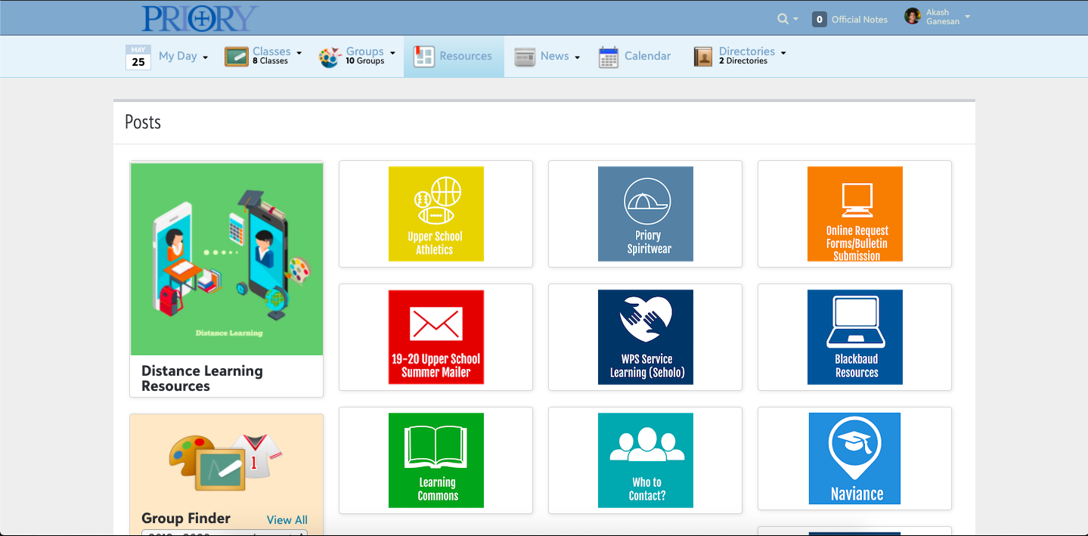

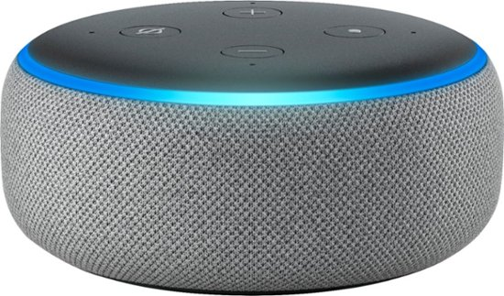
Designing an Alexa Skill for Priory School
Notes:
Being able to talk to computers is no longer in the realm science fiction. Using voice assistants such as Alexa, Siri and Google Voice, it is now possible to talk to computers.
As members of the Priory community, we find information about Priory using its website, looking through emails, reading handbooks or simply asking other members of the community.
My project aims to make Priory School information accessible via an easy to use voice interface.

Slide 4
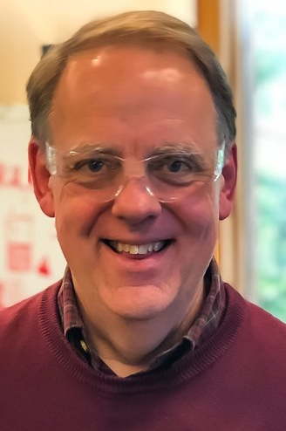
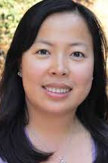
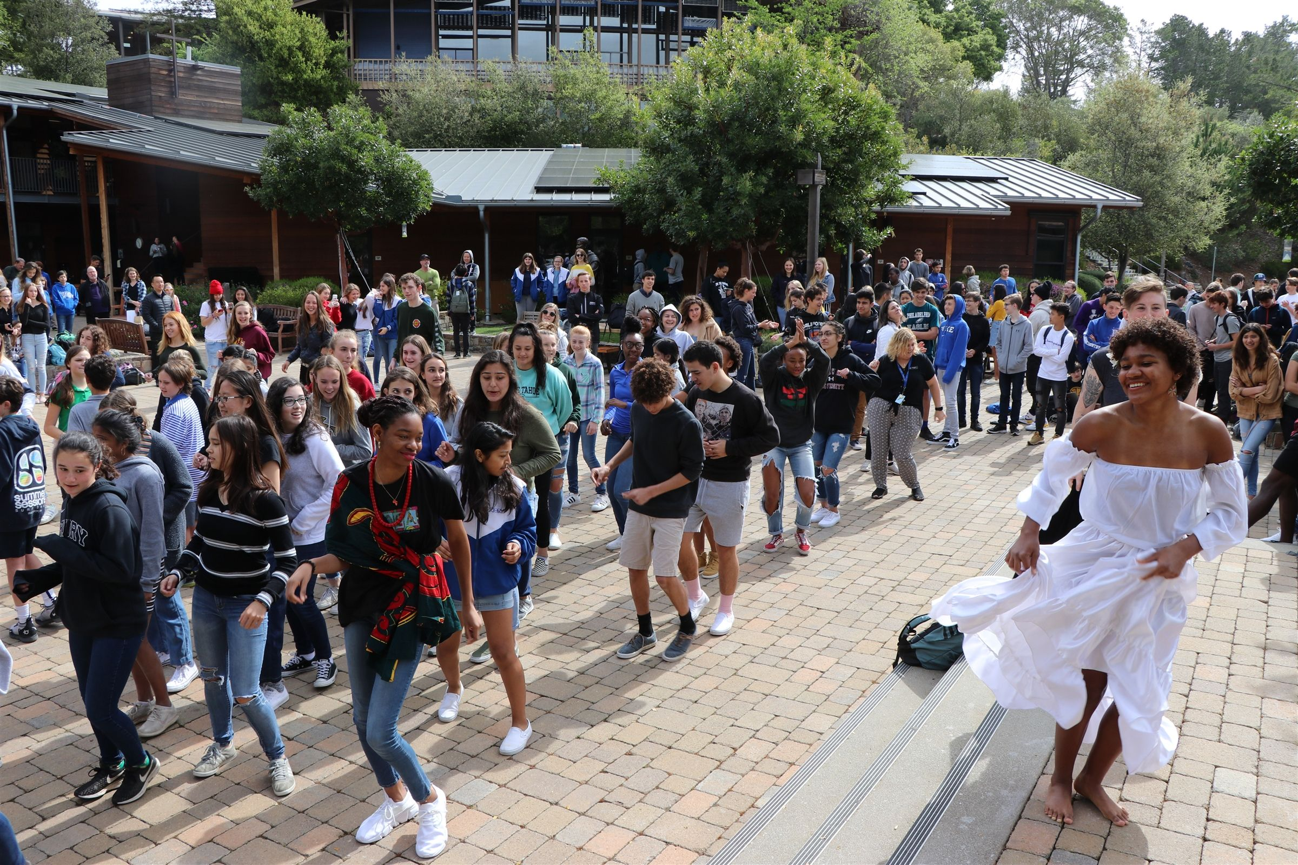
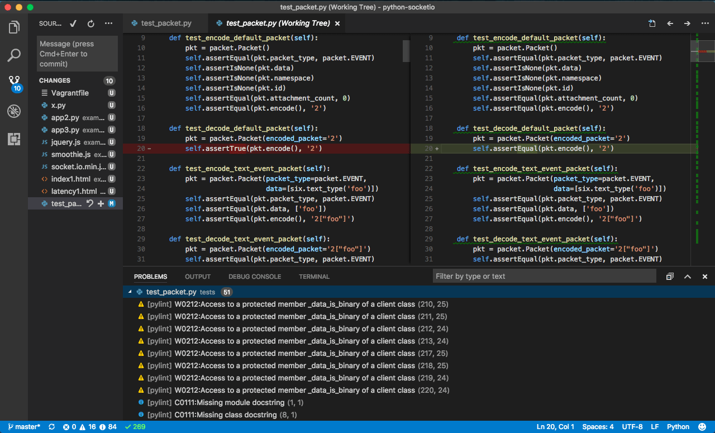
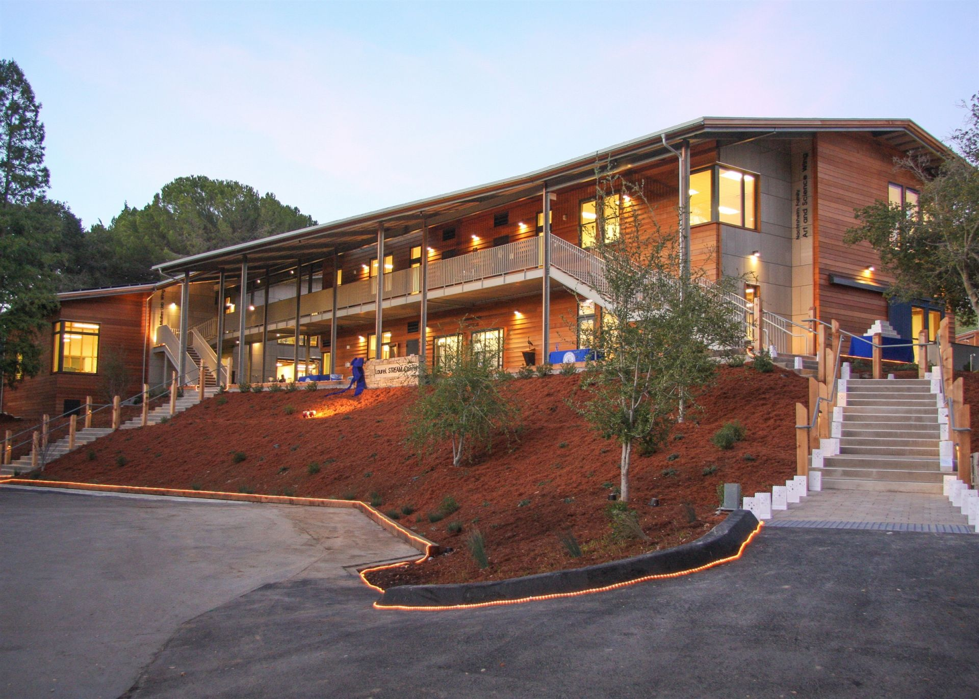
Why is this Project Meaningful?
Notes:
I really like Computer Science and Math.
In Priory, you can start from basic programming and go all the way to learning about artificial intelligence and machine learning. I have made good use of this opportunity and taken a Computer Science class every year I have been at Priory. Mr. Page and Ms. Hemiup have taught me pretty much everything I know about Computer Science.
Also, I have been incredibly fortunate to be a part of the Priory community for the last 4 years. This project is a way for me to give back to the Priory community.
I hope that being able to simply ask for information about Priory school using an Alexa device will make people's day to day lives a little bit better.
Computer, “Roll the demo...”

Slide 5
Demo

Slide 6
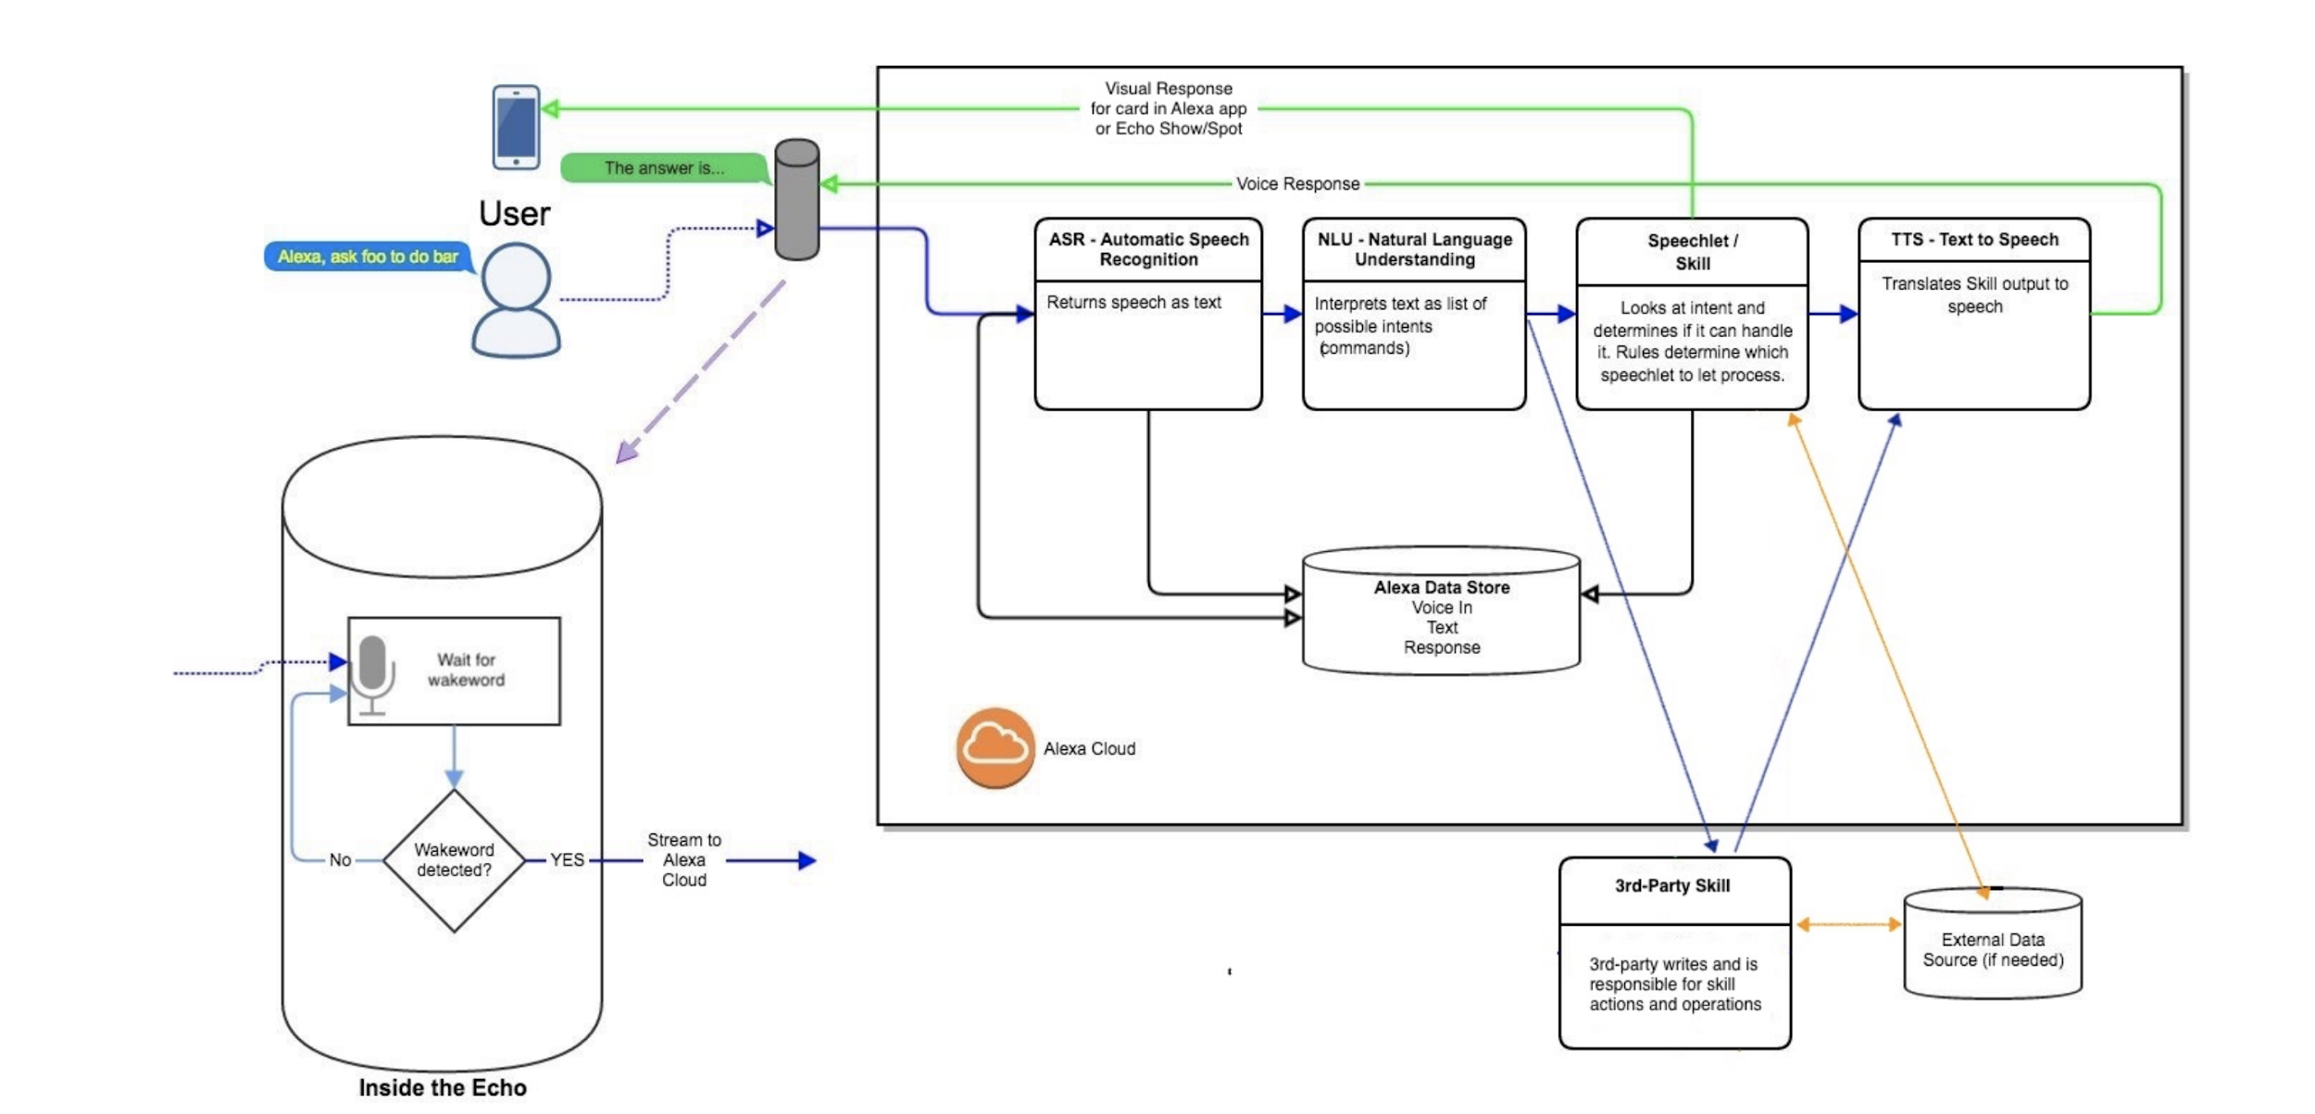
How Does it work?
1
2
3
5
4
Notes:
When you ask Alexa a question, you get an answer back. There are 5 steps involved in this process.
Step1: The user speaks a wakeword followed by a question. When the wakework is detected, the echo device captures the audio and sends it to the cloud.
Step2: The automatic speech recognition engine converts the audio into text. This text cannot be understood by computers as it comes out.
Step3: Natural Language processing takes the above text as input and converts it into simple actions or intents that the computer can understand.
Step4: In this project, step 4 is something that I implemented. For every intent, I have custom code that would produce an appropriate text output.
Step5: The text to speech engine converts the text output from step 4 into audio. This process is called speech synthesis. The generated audio is delivered to the Alexa device and played back

Slide 7
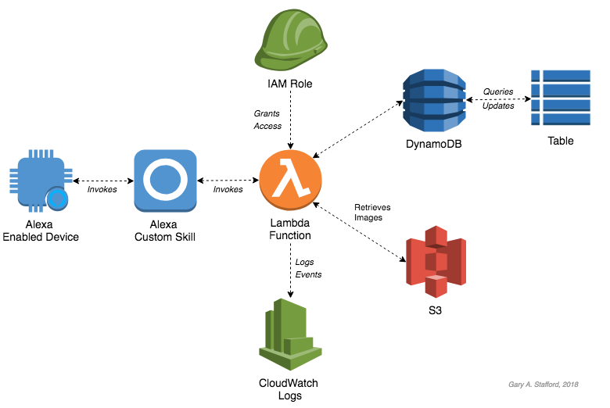
Alignment with Senior Project Mission
Senior Project gives students the opportunity to challenge and stretch themselves as individuals and intellectuals
Notes:
One of the goals of the senior project in Priory is for students to challenge themselves and push their limits.
Though I have decent skills in basic computer science, this project involved learning new technologies such as cloud computing, Alexa Skill development, DynamoDB, Serverless infrastructure (AWS Lambda), ect.
This project pushed me much further than I initially anticipated, and I hope that this sets me up in the future to take on tougher challenges and allow me to contribute to society.

Slide 8
My Mentor
Michael Freed, Principle Engineer at Cisco
Has over 30 years of experience in technology
Expert in networking, security, video, cloud computing and distributed systems
Helped me with architecture and design of the project
Helps me on an ongoing basis
Notes:
I keep Michael updated on my progress, and he helps me review my ongoing design and answers questions such as how I would go about securing the application, updating DynamoDB, running periodic jobs, writing proper testing and error handling code, and more.

Slide 9
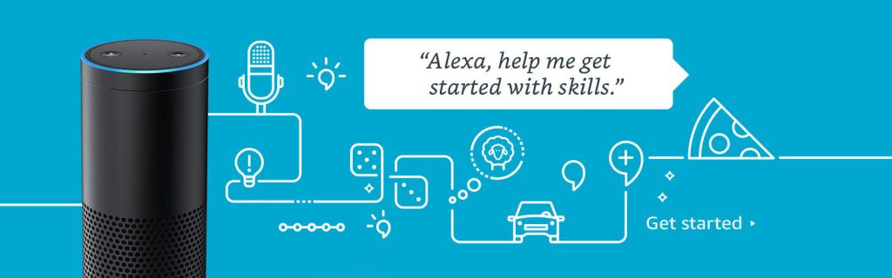
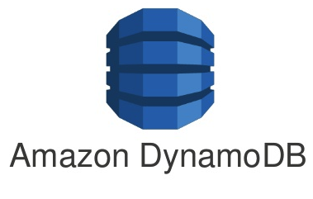
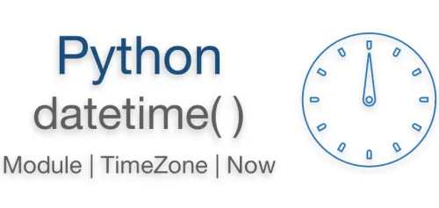

Research and Resources
Notes:
I would like to talk about 4 resources that helped in this project.
Python - Learn Python in Y Minutes
This project was developed in Python. When I started this project, I only had a basic knowledge of Python. This site helped me learn Python fast.
DynamoDB -- Developing with Python and DynamoDB
The events from the Priory calendar, Priory facts and FAQs need to be stored in the cloud for easy retrieval by the skill. I used an Amazon Web service called DynamoDB to store and retrieve data based on specific attributes. This tutorial taught me how to use DynamoDB
Alexa -- Build an Engaging Alexa Skill
This tutorial taught me how to build a basic Alexa skill. I learned about concepts such as language models, intents, samples, and slots.
Intents are actions that are taken to fulfill the users request.
Samples are sample utterances by the user.
Slots are variables such as dates and times passed to an intent.
I also learned about AWS Lambda. AWS Lambda is an Amazon web service which invokes the code that I wrote when a user interacts with my skill.
Datetime - Basic Date and Time Types
This Python library is the date/time library which allowed me to handle dates and times. The library allows me to do addition and subtraction with dates, and handled things like leap years. It also had a feature where it numbered the weeks.

Slide 10
Progress
3/24: Priory Calendar Download
3/18: Test Intent
4/2: DynamoDB instantiated
Notes:
3/18/2020
Managed to implement an Alexa intent that responds with “test test test” when asked any question
3/24/20
I was able to download Priory calendar an ical file from the priory website. I also found a way to extract events and store them as a Python pickle file.
4/2/2020
Got DynamoDB working. I needed to call Michael and he guided me through the steps needed to get DynamoDB and AWS working.

Slide 11
Progress
5/20: Days of a specific event
4/14: Events on a specific day
5/24: Priory facts
Notes:
4/14:
Given a specific day, Alexa will list all the events on that day. If there are no events, she will tell you that there are no events on this date.
I also added a feature that allows you to ask Alexa what kind of week the current week is
5/20
Given a specific event, Alexa will tell you the day or days on which it occurs. I had to use what is called fuzzy matching. For example an event may be listed on the calendar as “winter break”, but the user may ask “when is winter holiday.” Fuzzy matching enabled me to find the best match for such cases.
5/24:
Implemented an intent which would tell you a random fact about Priory when prompted.

Slide 12



Challenges
Notes:
The blogging part of Senior Project was difficult. Describing the technical process in a way that was easy to understand for a wider audience was challenging for me.
I have always developed code on my laptop. Developing code in the cloud for this project was hard for me.
I had to edit, deploy, and run the code, and look through the logs to find bugs. Several times I ended up looking at the wrong logs (which made debugging next to impossible).
I will have to get better at developing in the cloud...
I ran into a couple of Amazon Alexa service related bugs which slowed down my progress
Alexa services would sometimes call the wrong intent. This made debugging very difficult. I had to rebuild the language model several times to solve this.
I was unable to deploy my code and I had to open a support case. I am still in the process of getting this issue resolved

Slide 13
Enduring Understandings

Slide 14
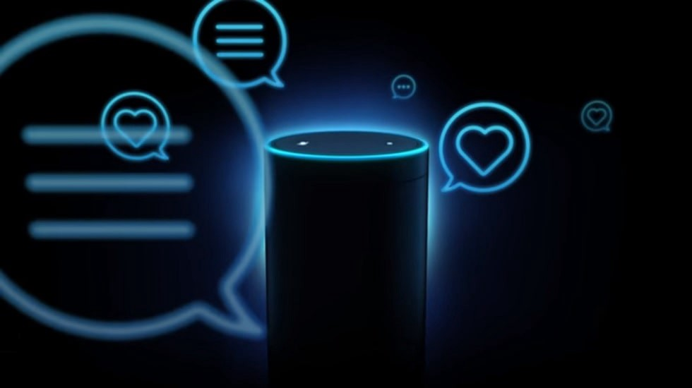
What does the Future Hold?
Notes:
Alexa, Can you tell the viewers on my behalf what the future holds?
Based on this experience, Aakash would like to build Alexa skills for non-profit organizations and his elementary school.
Aakash realizes how incredibly sophisticated the Alexa service that he used to build the skill is. He would like to learn more about what makes these technologies tick. Aakash would like to contribute to advancing artificial intelligence and machine learning.

Slide 15
Enable Priory Alexa
Please enable the Priory School skill on your Amazon Echo devices, use it and send me feedback to help improve the product.
To enable the skill just say: Alexa, Enable Priory School
Notes:
Thank you Alexa.
If you have an Amazon Echo device, please enable the Priory School skill, use it and send me feedback to help improve the product.
To enable the skill just say: Alexa, Enable Priory School
Stop share and thank viewers in person:
Thank you so much for taking the time to listen to my senior project. I look forward to getting feedback on this project from you.

